Slide 1



Department of CSE H
PROBABILITY STATISTICS AND QUEUING THEORY
22mt2005
Topic:
ADDITION RULE
Session - 2
CREATED BY K. VICTOR BABU

Slide 2













AIM OF THE SESSION
To familiarize students with the basic concepts of Probability
INSTRUCTIONAL OBJECTIVES
This Session is designed to:
Describe addition theorem on Probability
List out the properties based on addition rule
LEARNING OUTCOMES
At the end of this session, you should be able to:
Understand the addition rule for any events and mutually exclusive events
Different properties based on the addition rule

Slide 3

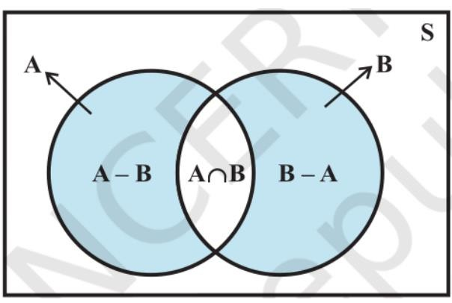
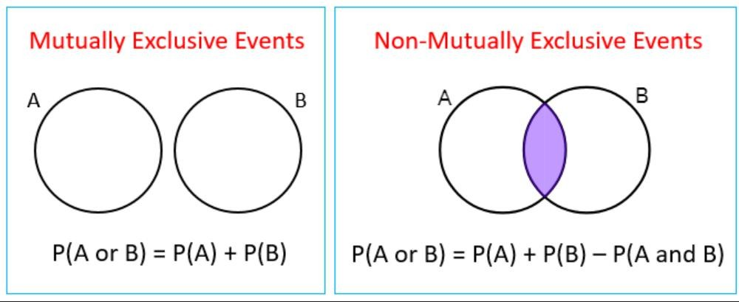
ADDITION THEOREM ON PROBABILITY
If A and B are any two events then
P(A𝖴B)=P(A)+P(B)-P(A∩ 𝐵)
If A and B are two mutually exclusive events (disjoint events) then P(A𝖴B)=P(A)+P(B)
source: https://ncert.nic.in/textbook.php?kemh1=16-16

Slide 4

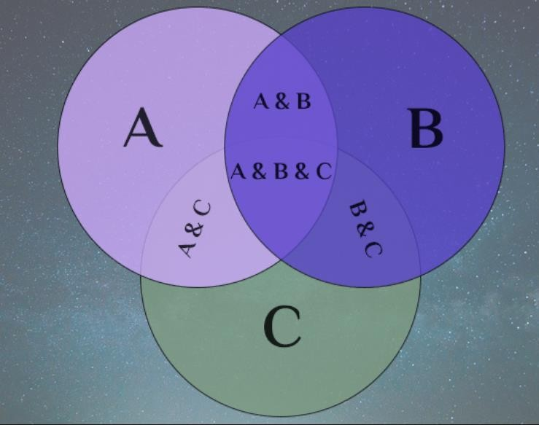
ADDITION THEOREM ON PROBABILITY
For three events A, B and C
P(A𝖴 B 𝖴 C) = P(A) + P(B) + P(C) − P(A ∩ B) − P(B ∩ C) − P(C ∩ A) + P(A ∩ B ∩ C)
If A, B and C three mutually exclusive events then
P(A𝖴 B 𝖴 C) = P(A) + P(B) + P(C)

Slide 5

Some Properties based on Addition Rule
If A and B are any two events then
P(A and B)=P(Both A and B)=P(A∩𝐵)
2. P(at least one)=P(Either A or B)= P(A∪B)=P(A)+P(B)-P(A∩𝐵)=P(A or B)
3. P(only A)=3. P(only A)=P(A)-P(A∩𝐵)=P(A∩𝐵)
4. P(only B)=P(B)-P(A∩B)=P(A∩B)
5. P(Anyone)=P(only one)=[P(A∩𝐵)∪P(A∩B)]= P(A∩𝐵)+P(A∩B)
=P(A)-P(A∩𝐵)+P(B)-P(A∩B)

Slide 6




_{EXAMPLE}
Example: Suppose that in a senior college class of 500 students it is found that 210 smoke, 258 drink alcoholic beverages, 216 eat between meals, 122 smoke and drink alcoholic beverages, 83 eat between meals and drink alcoholic beverages, 97 smoke and eat between meals, and 52 engage in all three of these bad health practices. If a member of this senior class is selected at random, find the probability that the student
Smokes but does not drink alcoholic beverages.
eats between meals and drinks alcoholic beverages but does not smoke;
Neither smokes nor eats between meals.
Probability that the student does not have any habit
Solution: Let A, B, and C be the events that the student selected at random is found to be smoke, drink, alcoholic beverages and eat between meals, respectively.
From the given data

Slide 7


SUMMARY
In this session, addition rule and its properties have discussed.
Addition rule for any events
Addition rule for three events
Solving problems using the rules based on addition theorem of probability.

Slide 8









SELF-ASSESSMENT QUESTIONS
In a standard deck of 52 cards there are 13 diamonds and 13 hearts (red) and 13 spades and 13 clubs (black). Find the probability of choosing a card at random that is a spade OR a 7
(a) 1/52 (b) 1/13 (c) 4/13 (d) 17/52
2. If you draw one card from a standard deck, what is the probability of drawing a 5 or a diamond?
(a) 2/52 (b) 4/52 (c) 16/52 (d) 26/52

Slide 9

TERMINAL QUESTIONS
1. The probability that a new airport will get an award for its design is 0.16, the probability that it will get an award for the efficient use of materials is 0.24, and the probability that it will get both awards is 0.11.
what is the probability that it will get at least one of the two awards?
what is the probability that it will get only one of two awards?
what is the probability that it will get neither award
what is the probability that it will get award for its design only?
2. Consider randomly selecting a student at a certain university, and Let A denote the event the selected
individual has a Visa Credit card and B be the analogous event for a MasterCard. Suppose that P(A)=0.5,
P(B)=0.4 and P(A∩B)=0.25
Compute the probability that the selected individual has at least one of the two types of cards
Compute the probability that the selected individual has neither type of card

Slide 10

REFERENCES FOR FURTHER LEARNING OF THE SESSION
Reference Books:
Chapter 1 of TP1: William Feller, An Introduction to Probability Theory and Its Applications: Volume 1, Third Edition, 1968 by John Wiley & Sons,Inc.
Richard A Johnson, Miller& Freund’s Probability and statistics for Engineers, PHI, New Delhi, 11th
Edition (2011).
Sites and Web links:
* https://ncert.nic.in/textbook.php?kemh1=16-16 *
Notes: sections 1 to 1.3 of http://www.statslab.cam.ac.uk/~rrw1/prob/prob-weber.pdf
https://ocw.mit.edu/courses/res - 6 -012 -introduction -to -probability - spring - 2018/91864c7642a58e216e8baa8fcb4a5cb5_MITRES_6_012S18_L01.pd f 9

Slide 11

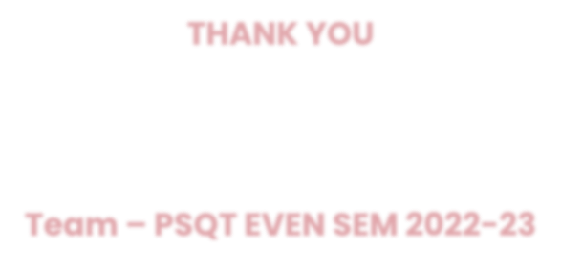
THANK YOU
Team – PSQT ODD SEM 2023-24

